Slide 1






Sentimental Analysis with Naive Bayes
Presented by Group FT26 (T03):
Ngoc Minh Khanh Tran (8577158)
Vania Graciella Kwee (8577201)
Wong Poh Yee (8561588)
Joshe Chantiramugan (8451242)
Niruba Annriea Kichor Sagayaradje (8560249)
Angeles Micah Josephine Flores (8575289)
Github: https://github.com/pohyeewpy/CSCI323-Assignment.git
YouTube:https://youtu.be/R6nPjoIamCg

Slide 2
Name | UOW ID | Contribution | Roles Distribution
Niruba Annriea Kichor Sagayaradje | 8560249 | 100% | Documenter, Coder
Joshe Chantiramugan | 8451242 | 100% | Documenter, Coder
Wong Poh Yee | 8561588 | 100% | Documenter, Coder
Vania Graciella Kwee | 8577201 | 100% | Documenter, Coder
Ngoc Minh Khanh Tran | 8577158 | 100% | Documenter, Coder
Angeles Micah Josephine Flores | 8575289 | 100% | Documenter, Coder

Slide 3


Problem Statement
Objectives
Restaurants receive numerous customer reviews every day, making it difficult to manually analyse feedback efficiently and extract meaningful insights for business improvement.
Classify reviews into positive, negative, neutral
Compare classifiers (Naive Bayes vs Logistic Regression vs SVM)
Evaluate performance based on accuracy & other metrics

Slide 4


Introduction
Sentiment analysis is a Natural Language Processing technique that identifies whether text expresses positive, negative, or neutral sentiment. It is widely used for customer feedback, social media insights, and brand monitoring. This project applies sentiment analysis to Google food reviews, enabling faster evaluation of customer satisfaction.

Slide 5


02
Dataset and
Classifiers used

Slide 6
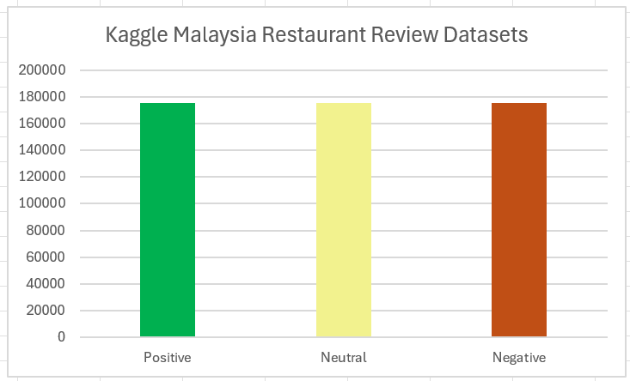

Datasets used
Dataset sources: Kaggle Malaysia Restaurant Review Datasets
Total records: 526K+ listings (Google and TripAdvisor)
Class distribution:
  Positive 175633
  Neutral 175633
  Negative 175633
Malaysia Kaggle dataset with reviews more closed to Singaporean style, includes common Singlish phrases like “shoik” and “sedep,”, allowing our model to learn and classify sentiments especially for Singapore food business reviews accurately

Slide 7
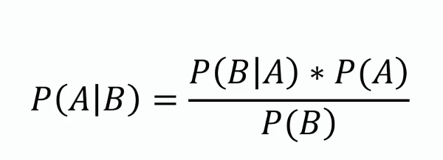
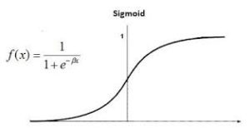
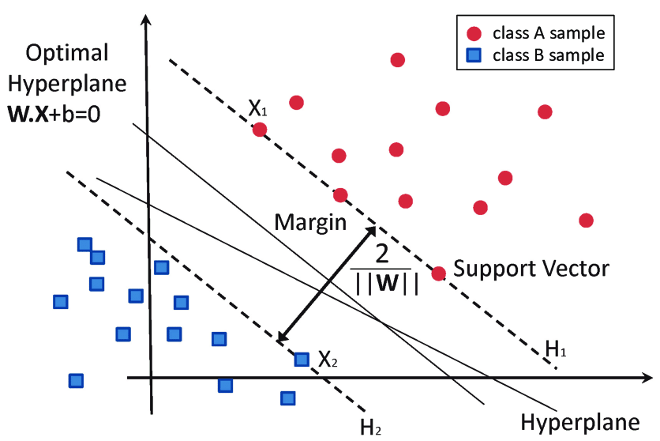
Classifiers used for testing
Naive
Bayes
Logistic Regression
Support
Vector
Machine

Slide 8
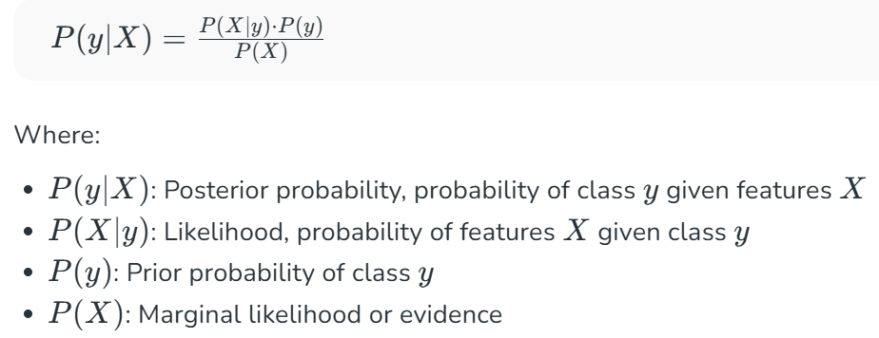
Naive Bayes
Naïve Bayes is a probability machine learning algorithm that classifies text by applying Bayes Theorem through assuming that all features are independent of each other. The formula is shown below:

Slide 9
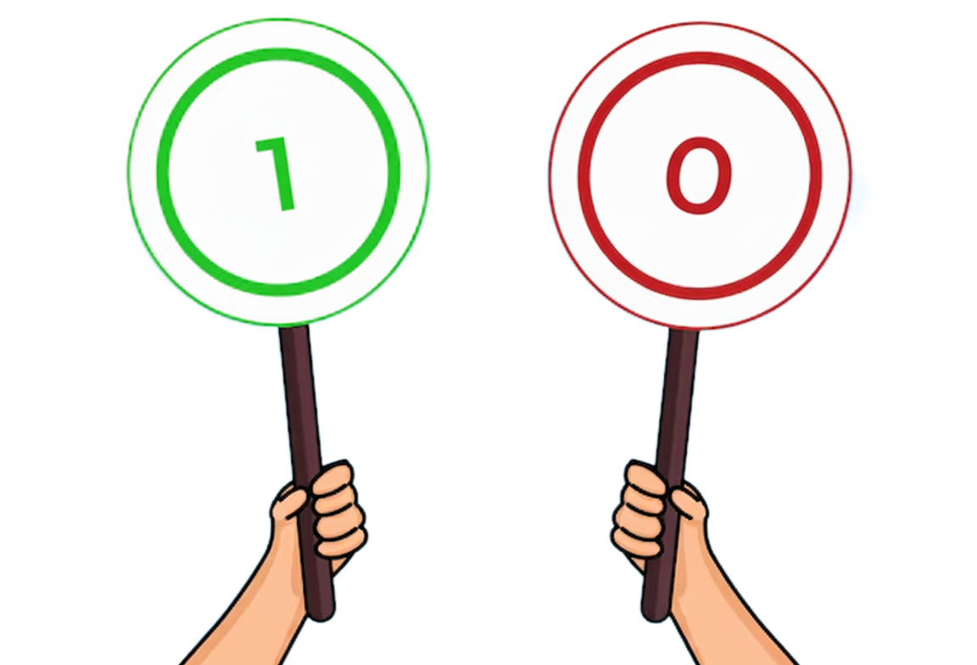
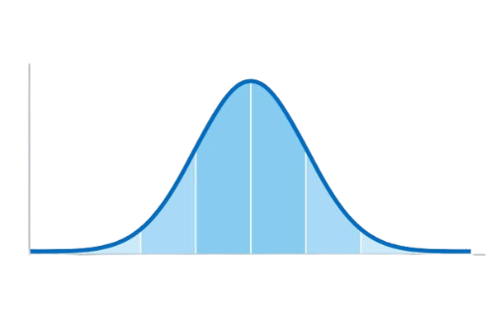
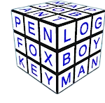
Types of Naive Bayes
Gaussian Naive Bayes
Multinomial Naive Bayes
Bernoulli Naive Bayes
is used for continuous features such as age and height, which are assumed to be distributed according to a Gaussian distribution within each class.
is used when features represent the frequency of terms such as word counts in a document. It is commonly applied in text classification, where term frequencies are important.
is used to deal with binary features, where each feature indicates whether a word appears or not in a document. It is suited for scenarios where the presence or absence of terms is more relevant than their frequency.
(GeeksforGeeks, 2017)

Slide 10

Logistic Regression (LR)
In 3 types of logistic function, we use Multinomial Logistic Regression, which is a discriminative model that estimates the probability of each sentiment class (positive, neutral, negative) using the softmax function:
It models the relationship between TF-IDF text features and sentiment polarity without assuming any underlying distribution. The model learns parameters by maximising the log-likelihood across all classes.
Notes:
Explanation simplify

Slide 11
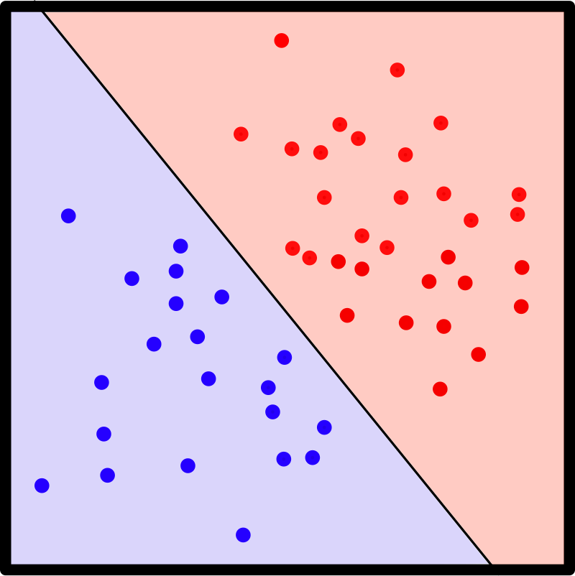
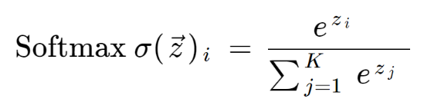
Logistic Regression
Data are approximately linearly separable
Softmax layer ensures probabilistic predictions
L2 regularisation reduces overfitting in high-dimensional text data
LR may struggle with non-linear sentiment cues (e.g., sarcasm) or class imbalance
Notes:
Explanation simplify

Slide 12


Linear SVM
Support Vector Machine is a discriminative classifier that aims to find the optimal hyperplane that maximally separates data points of different sentiment classes in the feature space.
For multi-class sentiment analysis, the One-vs-Rest (OvR) strategy is commonly used, training one classifier per class (positive, neutral, negative)
SVM minimizes classification error by maximizing the margin between support vectors and the decision boundary, defined as:
subject to

Slide 13
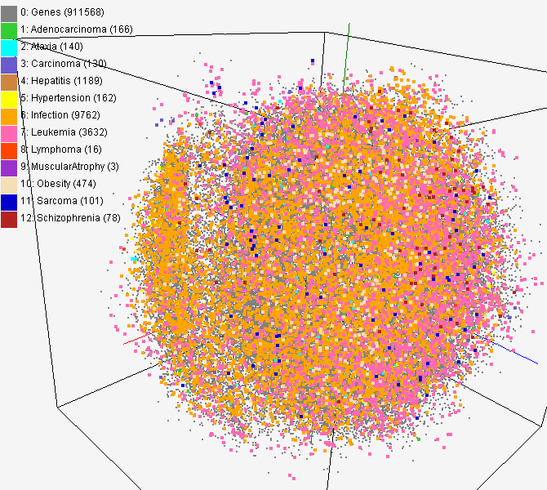
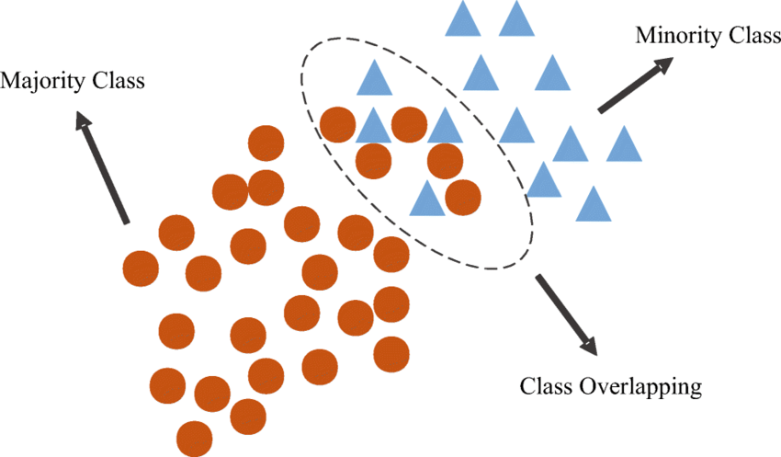
Support Vector Machine (SVM)
SVM performs well on high-dimensional text data such as TF-IDF vectors
Struggles with overlapping sentiment boundaries or noisy data and may require tuning of the kernel and regularization parameter (C)
Despite this, SVM remains a robust baseline for accurate and margin-based sentiment classification.

Slide 14

03
Implementation
steps
Preprocessing and classifiers

Slide 15

Data preprocessing
Text Normalization
1
Tokenization
Non-alphabet character, emoji, stopwords, lowercase and contraction expansion
After cleaning, split into individual words for later converting to numerical features to analyze
4
2
3
Train-test split
Feature
extraction
The dataset is divided into two subsets:
80% training
20% testing
Transformed into numerical vectors using TF-IDF

Slide 16
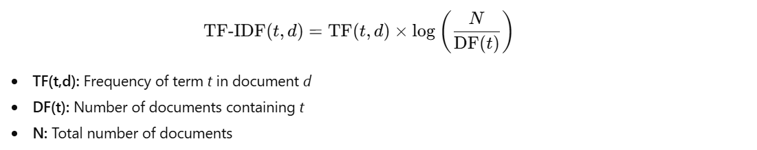

TF-IDF Feature Extraction
TF-IDF (Term Frequency–Inverse Document Frequency)
captures how relevant a word is to a particular review compared to all others.
A word gets a high TF-IDF score when:
It appears frequently in a particular document (high TF), and
It appears rarely across all other documents (high IDF).
This means such a word is unique and characteristic of that specific review.

Slide 17
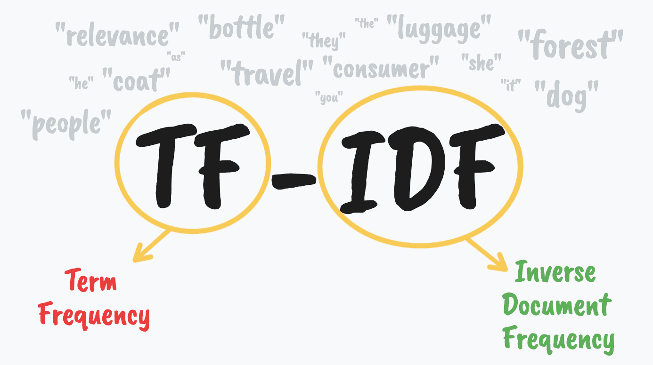
TF-IDF Feature Extraction
Goal: Convert text reviews into numerical vectors representing the importance of words.
Common words “good” or “food” get lower weights
Distinctive words “overpriced” or “excellent” get higher scores.
Helps classifier focus on informative words to separate sentiment categories (positive, neutral, negative)
Produces sparse vector, linearly separable feature space
Ideal for Multinomial Naïve Bayes, Logistic Regression, and SVM, which rely on linear decision boundaries to classify sentiment efficiently.

Slide 18
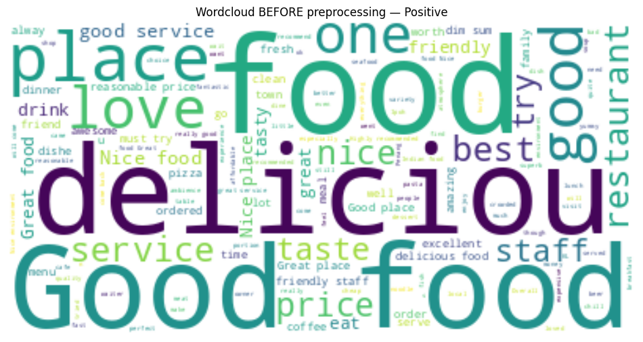
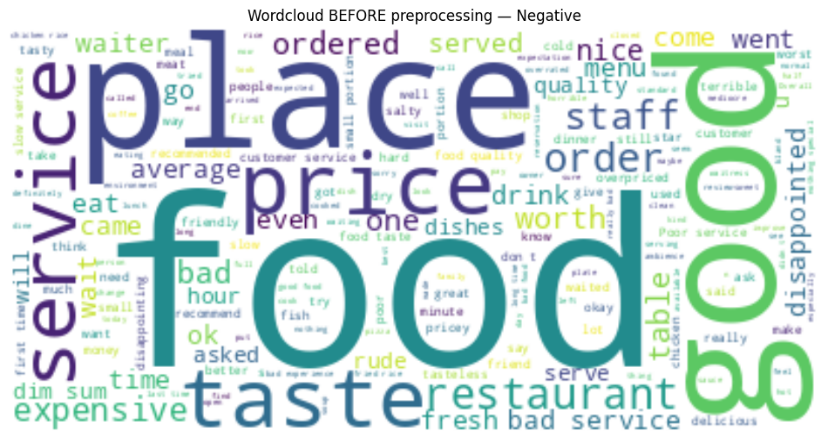
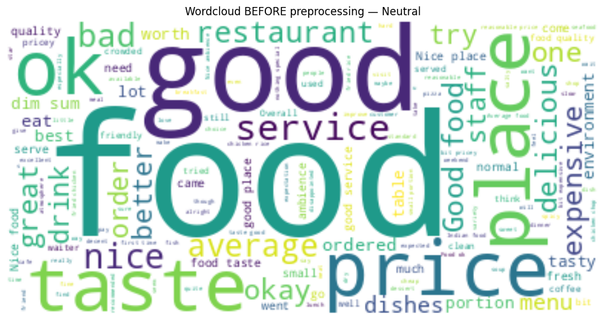
Wordcloud before preprocessing
BEFORE
“Food” “Good”
“Place” “Price”
Positive
Neutral
Negative
WordCloud is cluttered with irrelevant or non-sentiment words.
Notes:
Before preprocessing, we derived 3 wordcloud. all three wordclouds look very similar. Common domain words like food, good, place, price dominate every class. These words do not show real emotion and do not help the model separate Positive, Neutral and Negative. So the wordcloud is noisy and sentiment meaning is unclear — this shows why preprocessing was needed.

Slide 19
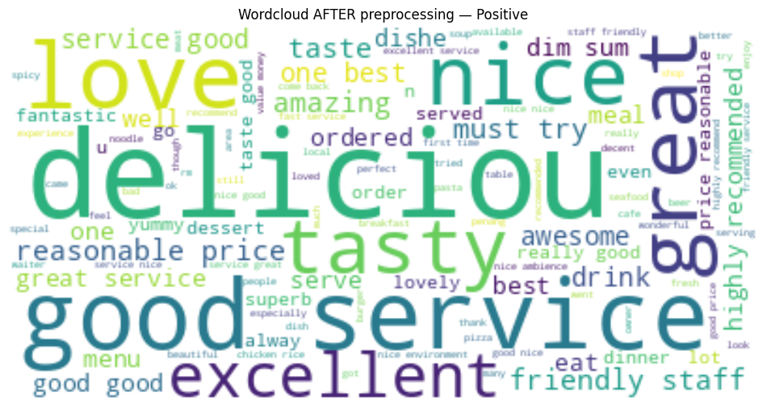
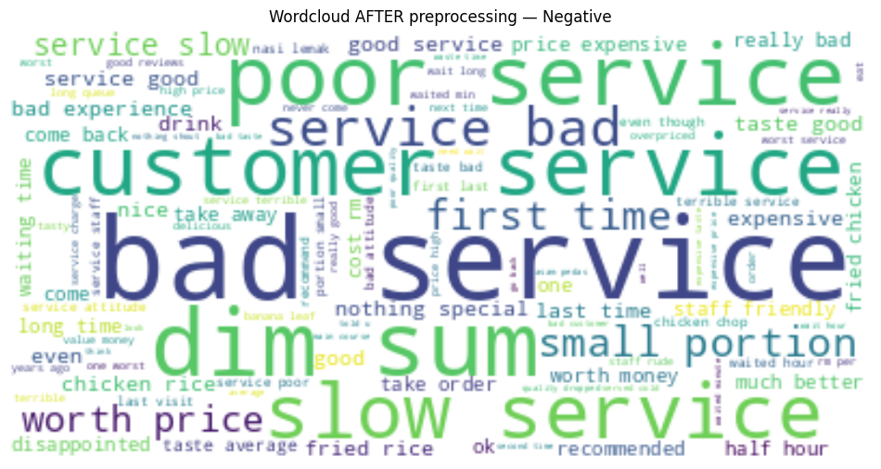
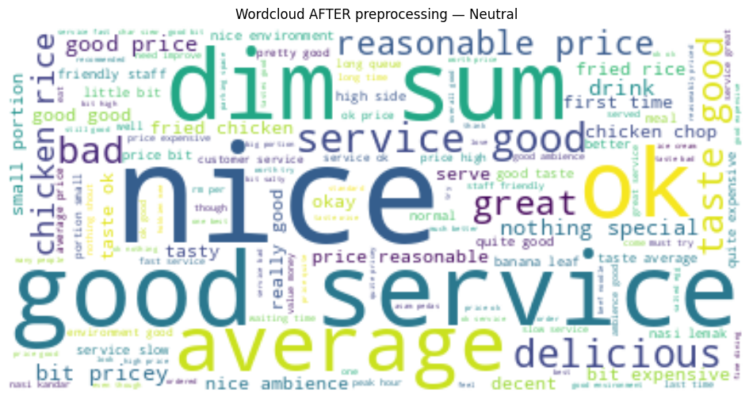
Wordcloud after preprocessing
AFTER
“Nice” “Ok”
“Average”
Positive
Negative
Neutral
“Delicious” “Good”
“Great” “Tasty”
“Bad” “Poor”
“Slow”
WordCloud highlights
meaningful words.
Notes:
For preprocsseing we created a custom stop word list with words such as “'restaurant','place','food','eatery','google','map','maps','review','place''malaysia','singapore','SG','KL','sg','kl','jb','JB',” were removed
Now the wordclouds shows much more meaningful sentiment words.
Positive reviews highlight emotional words like delicious, great, tasty.
Negative reviews clearly show words like bad, poor, slow, service.
Neutral shows more middle tone words like nice, ok, average.
This shows preprocessing successfully removed noise and allowed true sentiment patterns to appear clearly.

Slide 20
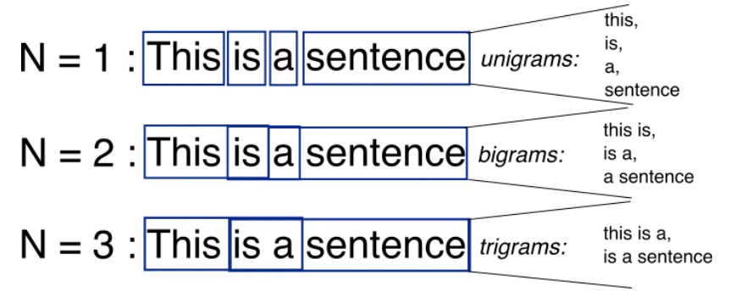
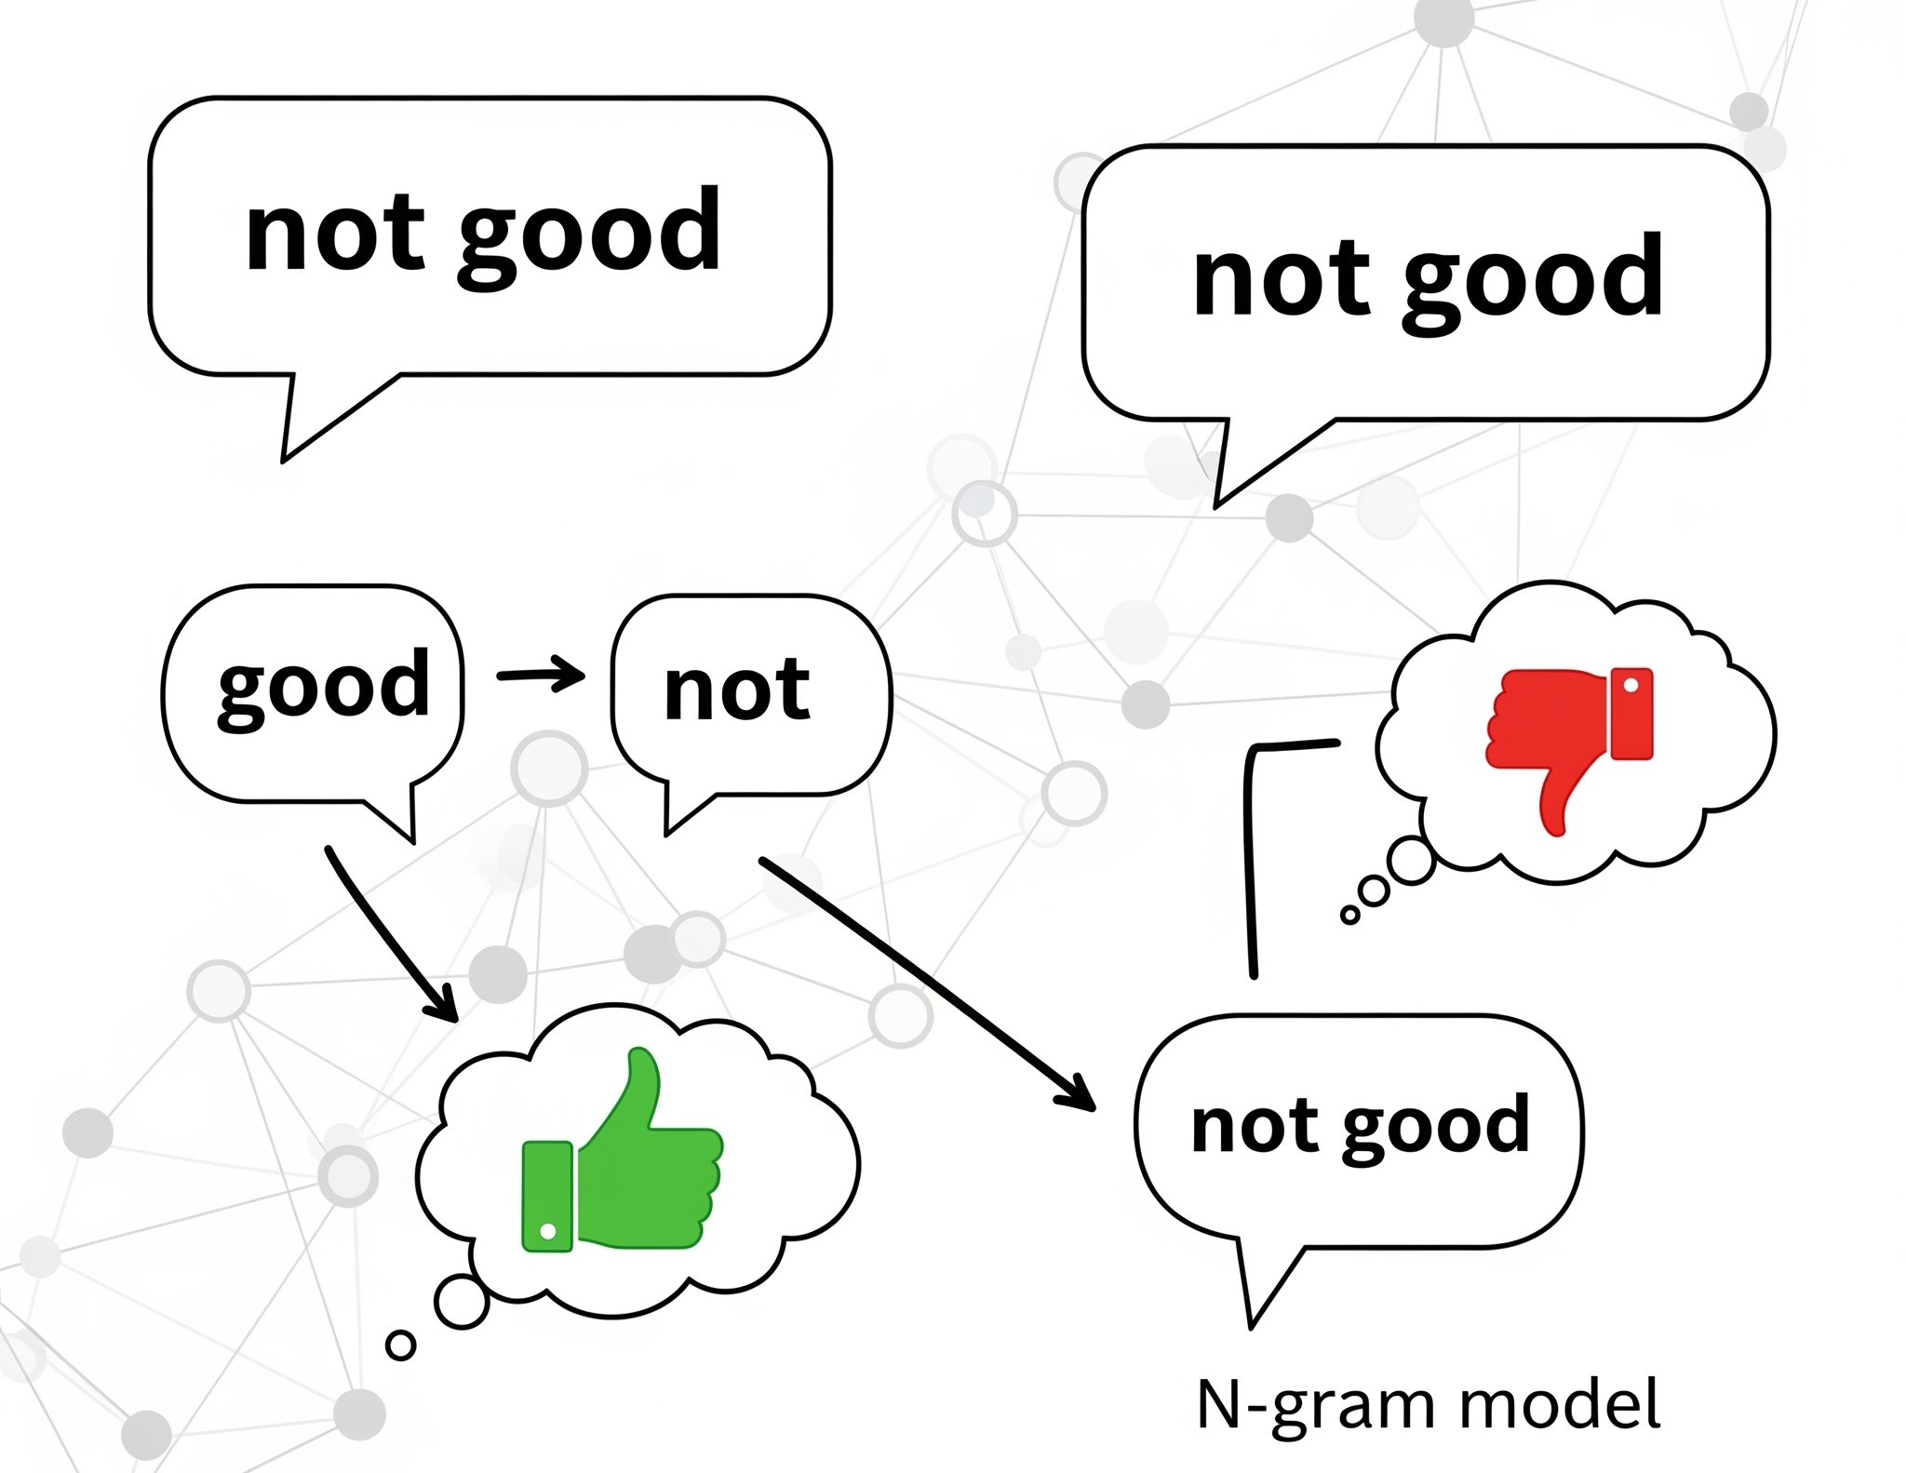
Implementation of Classifiers
The classifiers are trained using unigrams and bigrams from N-Grams.
N-grams capture contextual information and semantics within a sequence of words
Offers nuanced understanding of language essential for sentiment analysis.
For example, classifier trained on individual words, might misinterpret "not good" as positive based on the word "good."
Leads to inaccurate sentiment analysis.
Hence, by using N-grams, it allows our classifiers to consider combinations like "not good",
resulting in more reliable sentiment analysis.
Notes:
N-grams allow the model to understand combinations of words instead of treating every word as isolated.
This is critical because sentiment often changes when words appear together.
For example, “good” by itself is positive, but “not good” expresses a negative meaning.
Therefore, N-grams capture this contextual shift, allowing our classifiers to interpret sentiment more accurately.
To properly experiment with semantic context, we trained our classifiers using both unigrams and bigrams.

Slide 21
04
Results and
Discussion

Slide 22
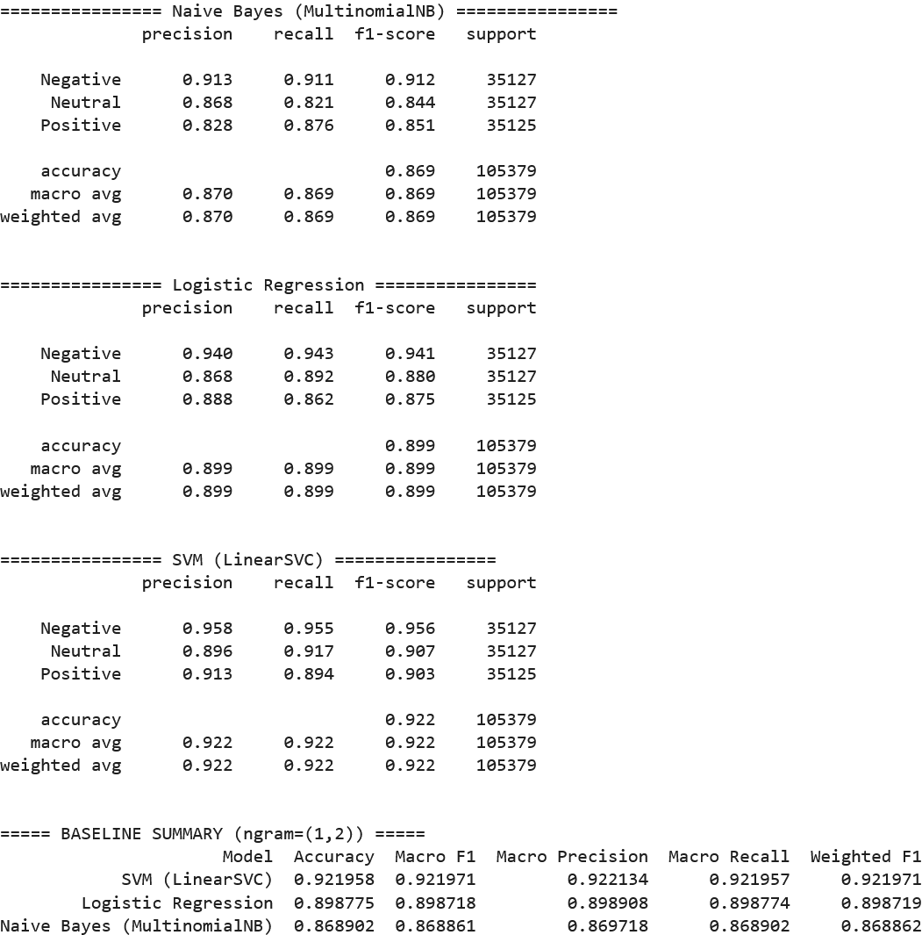
Results - Naive Bayes
Overall behaviour:
High overall accuracy, strong consistent class performance
Negative and positive handled well, high precision and recall
Neutral reviews slightly weaker, suggests confusion between neutral and nearby sentiments
Possible reasons:
Vocabulary-frequency driven → multiplies token probabilities per class
Positive words (“good”, “nice”, “ok la”, “normal”) appear widely across reviews
Slightly bias toward positive predictions, but less severely than in smaller datasets
Notes:
Negative:
High precision (0.913) and high recall (0.911) → accurately identifies most negatives.
Performs best among all classes with F1 = 0.912.
Neutral:
Moderate precision (0.868) and lower recall (0.821) → occasionally misclassifies borderline reviews as Positive or Negative.
Struggles slightly with distinguishing Neutral tone.
Positive:
Good balance between precision (0.828) and recall (0.876).
Slight bias toward predicting Positive when sentiment is unclear.
For Naive Bayes, we can see that all three classes perform well, with strong precision and recall across Negative, Neutral and Positive. Overall accuracy is 86.9%, which indicates NB is able to classify most reviews correctly. Neutral is slightly weaker than the other two classes, showing that it still struggles a bit with mid-tone or borderline reviews.
This behaviour is expected because Naive Bayes is vocabulary-frequency driven. It calculates sentiment based on how often words appear in each class. Some mild positive words such as “good”, “nice”, or “ok la” still appear across many reviews, so NB may still slightly lean towards positive predictions sometimes. But overall, NB’s performance is stable and much more balanced now.

Slide 23
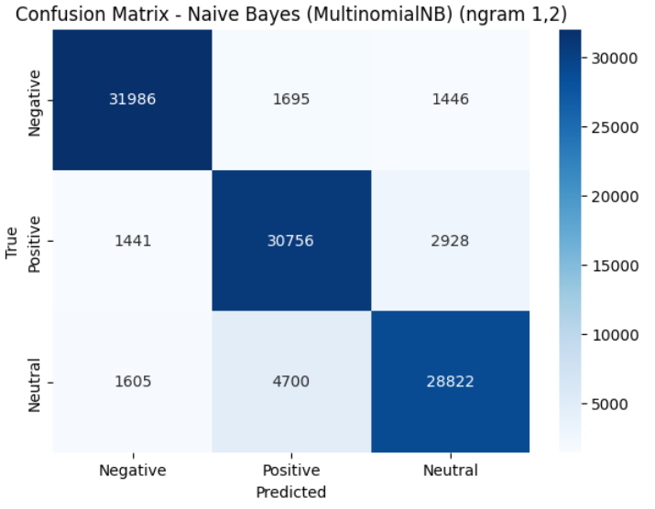
Confusion Matrix Comparison
Multinomial Naive Bayes
Moderate bias to positive class
Correctly predicted 30,756 positive, 28,822 neutral and 31,986 negative instances
Bias further indicated by high number of misclassifications as positive:
  Neutral misclassified as positive 4,700 times
  Negative misclassified as positive 1,695 times
Results suggest model struggles to differentiate subtle sentiments
between neutral and negative classes
Notes:
The Multinomial Naive Bayes model exhibits a moderate bias toward the Positive class, as shown in the confusion matrix.
The model correctly predicted 30,756 Positive instances, significantly more than the 28,822 Neutral and 31,986 Negative instances.
This bias is further reflected in the misclassifications toward the Positive label:
Neutral class was misclassified as Positive 4,700 times.
Negative class was misclassified as Positive 1,695 times.
These results suggest that the model still struggles to differentiate subtle sentiments, particularly between Neutral and Negative reviews, where overlapping vocabulary (e.g., “okay,” “normal,” “not bad”) leads to confusion.
Looking at the confusion matrix for Naive Bayes, we can see that while the model performs well overall, it still shows a slight bias towards predicting the Positive class. NB correctly identifies a large number of Positive, Neutral and Negative instances, but we can also see that Neutral and Negative reviews are sometimes misclassified as Positive. This indicates that Naive Bayes still struggles with the subtle sentiment boundary between Neutral and Positive. Overall, this matrix confirms that NB performs strongly, but still tends to lean slightly toward Positive when uncertainty happens.

Slide 24
Results - Logistic Regression
Overall behaviour:
More balanced than Naive Bayes
Better at catching negative and neutral reviews
Consistently strong across all classes (high macro F1)
Possible reasons:
Learns weighted decision boundaries in TF-IDF space
Balance 3 classes instead of over-predicting one
Improves Neutral and Negative detection while maintaining high overall accuracy
Notes:
Negative: Excellent detection; very few false negatives or positives.
Neutral: High recall and precision; distinguishes Neutral reviews effectively.
Positive: Slightly lower recall; predicts Positive only when confident.

Slide 25
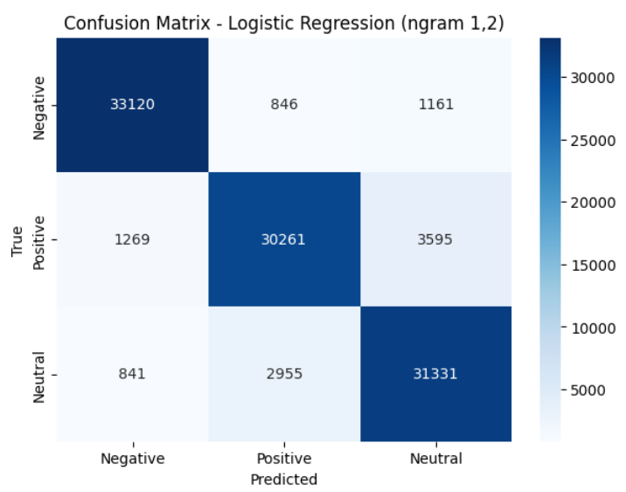
Confusion Matrix Comparison
Logistic Regression
Improved overall performance and better class balance compared to Multinomial Naive Bayes
Correctly predicted 30,261 positive, 31,331 neutral and 33,120 negative.
Misclassifications are lower than NB:
  Neutral misclassified as positive 2,955 times
  Negative misclassified as positive 846 times
Results suggest Logistic Regression has stronger ability to distinguish between positive, negative, and neutral sentiments compared to the Multinomial Naive Bayes
Notes:
The Logistic Regression model demonstrates improved overall performance and stronger class balance compared to the Multinomial Naive Bayes model.
The model correctly predicted 30,261 Positive instances, along with 33,120 Negative and 31,331 Neutral reviews, showing consistent accuracy across all classes.
This balance indicates that Logistic Regression effectively distinguishes between different sentiment polarities.
Misclassifications are comparatively lower:
Neutral class was misclassified as Positive 2,955 times.
Negative class was misclassified as Positive 846 times.
These results suggest that the Logistic Regression model captures subtle sentiment cues more effectively and maintains clearer separation between Positive, Neutral, and Negative reviews, reducing the over-prediction bias observed in Naive Bayes.

Slide 26
Results - SVM
Overall behaviour:
Most balanced model overall
Handles all three sentiment classes better than Naive Bayes or Logistic Regression
Displays strong and high consistency in identifying and predicting all three classes
Possible reasons:
Clearer decision boundaries in high-dimensional TF-IDF space
Maximise class separation, reduce bias toward positive class in Naive Bayes
More robust against overlapping word usage across sentiments
Notes:
Negative: Excellent precision and recall; accurately identifies true negatives.
Neutral: Strong Neutral classification; effectively handles ambiguous language.
Positive: High precision and recall; performs best without over-calling positives.

Slide 27
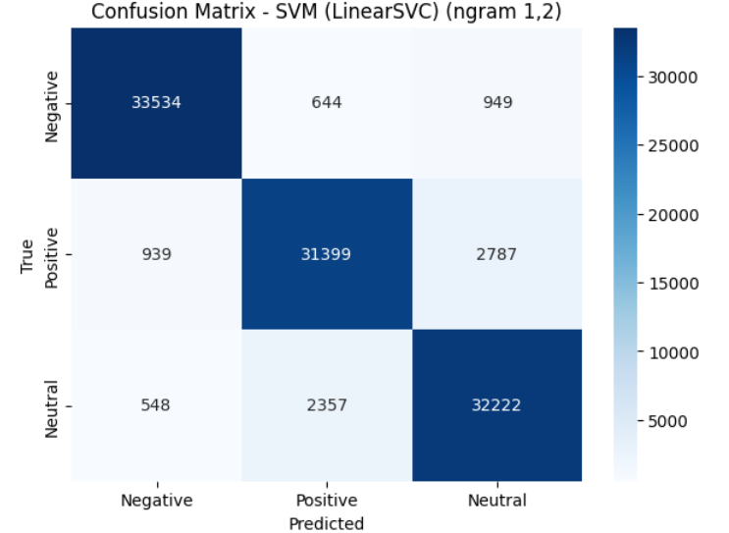
Confusion Matrix Comparison
SVM (Linear SVC)
Strongest overall performance and class balance among all three models
Correctly predicted 31,399 Positive, 32,222 Neutral, and 33,534 Negative instances
Misclassifications are minimal:
  Neutral misclassified as positive 2,357 times
  Negative misclassified as positive 644 times
Effectively captures subtle linguistic patterns and maintains clear separation between Positive, Neutral, and Negative reviews, outperforming both Naive Bayes and Logistic Regression.
Notes:
SVM (Linear SVC)
The Linear SVM (LinearSVC) model demonstrates the strongest overall performance and class balance among all three models.
It correctly predicted 31,399 Positive, 32,222 Neutral, and 33,534 Negative instances, showing high consistency across sentiment categories.
Misclassifications are minimal:
Neutral → Positive: 2,357 instances.
Negative → Positive: 644 instances.
These results indicate that the Linear SVC model effectively captures subtle linguistic patterns and maintains clear separation between Positive, Neutral, and Negative reviews.
The reduced confusion between Positive and Neutral classes highlights its superior ability to interpret nuanced text sentiment, outperforming both Naive Bayes and Logistic Regression.

Slide 28
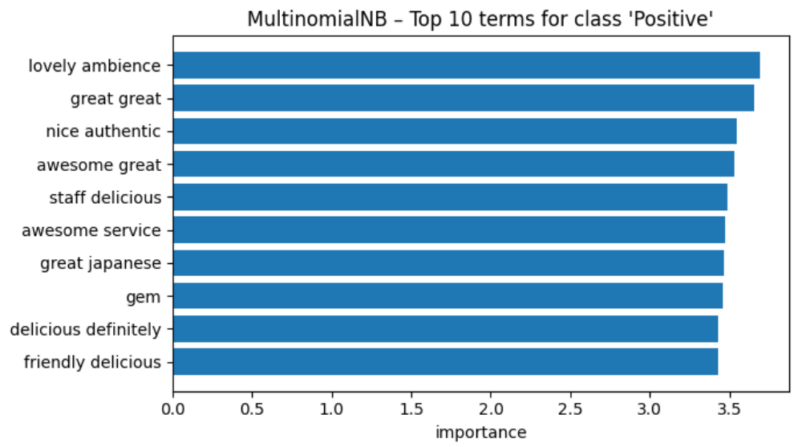
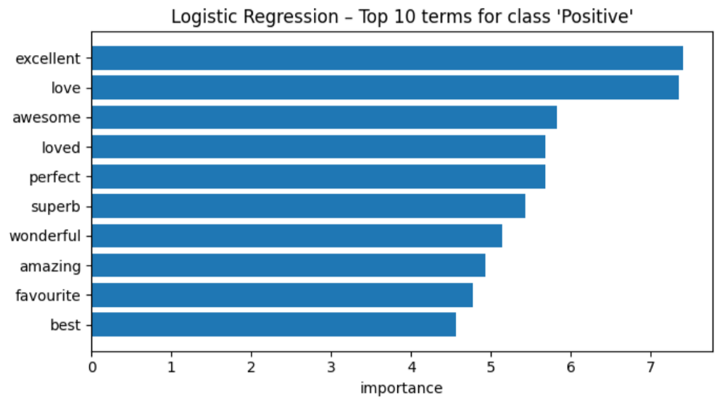
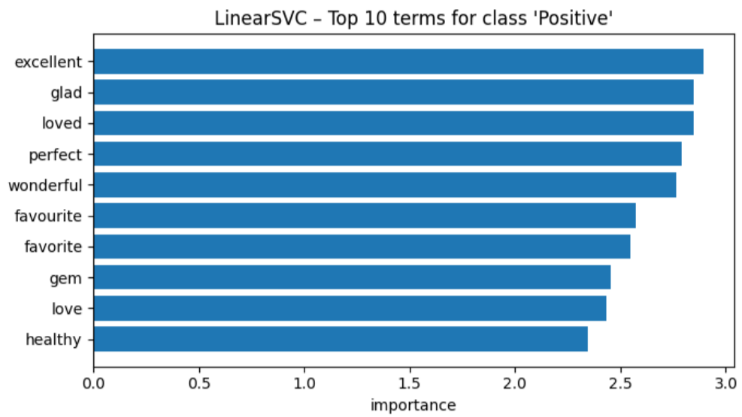
Top 10 Positive Words
Naive Bayes
Probability frequency based, relies on frequent words/bigrams.
Context specific restaurant phrases not universal phrases (e.g. “lovely ambience”)
Quickly locks onto words linked to Positive sentiment
Performs well on clear polarity, but struggles with subtle tone
Logistic Regression
Focuses more on universal sentiment power words (“excellent”, “love”)
Strong universal polarity adjectives
Discriminative, weights words consistently push decision boundary towards “Positive”
Disregards domain context
SVM:
Pick similar universal positive words
Discriminative models, don't rely on raw frequency
Stronger emphasis on words that maximise margin separation
Performs better overall in subtle sentiment cases even if the top words look similar

Slide 29

Results: Model Performance Comparison
Model + ngram (1,1) | Accuracy | Macro F1 | Macro Precision | Macro Recall | Weighted F1
Naive Bayes (MNB) | 0.720 | 0.719 | 0.718 | 0.720 | 0.718
Logistics Regression | 0.756 | 0.755 | 0.755 | 0.756 | 0.755
SVM (Linear SVC) | 0.766 | 0.765 | 0.765 | 0.766 | 0.765
Model + ngram (1,2) | Accuracy | Macro F1 | Macro Precision | Macro Recall | Weighted F1
Naive Bayes (MNB) | 0.802 | 0.401 | 0.704 | 0.395 | 0.728
Logistics Regression | 0.766 | 0.613 | 0.591 | 0.655 | 0.786
SVM (Linear SVC) | 0.810 | 0.606 | 0.609 | 0.604 | 0.805
Notes:
Model Selection: SVM (Linear SVC) with model + ngram(1,2)
Highest accuracy among all models
Strong weighted F1, consistent performance across classes
Balanced precision and recall better than Naive Bayes and Logistic Regression
Generalizes well unseen data with clear class separation
Most robust and reliable model for overall sentiment classification
Ngram(1,2) is better as we consider 2 words, example “Good” can be “Very Good” or “Not Good”

Slide 30
Why SVM?
Maximum Margin Separation
Handles Subtle Semantics Better
maximises the distance between classes.
Making it more robust when Positive vs Neutral overlap
Despite LR and SVM both catch universal sentiment words. SVM stronger boundary separation than LR.
Best Generalisation
Balanced Performance
SVM is less sensitive to frequency spikes that mislead Naive Bayes, and less prone to overfitting extreme polarity like Logistic Regression
SVM achieves the most balanced macro F1 (0.606) across the 3 classes — NB collapses Neutral, LR is weaker on Neutral recall.

Slide 31
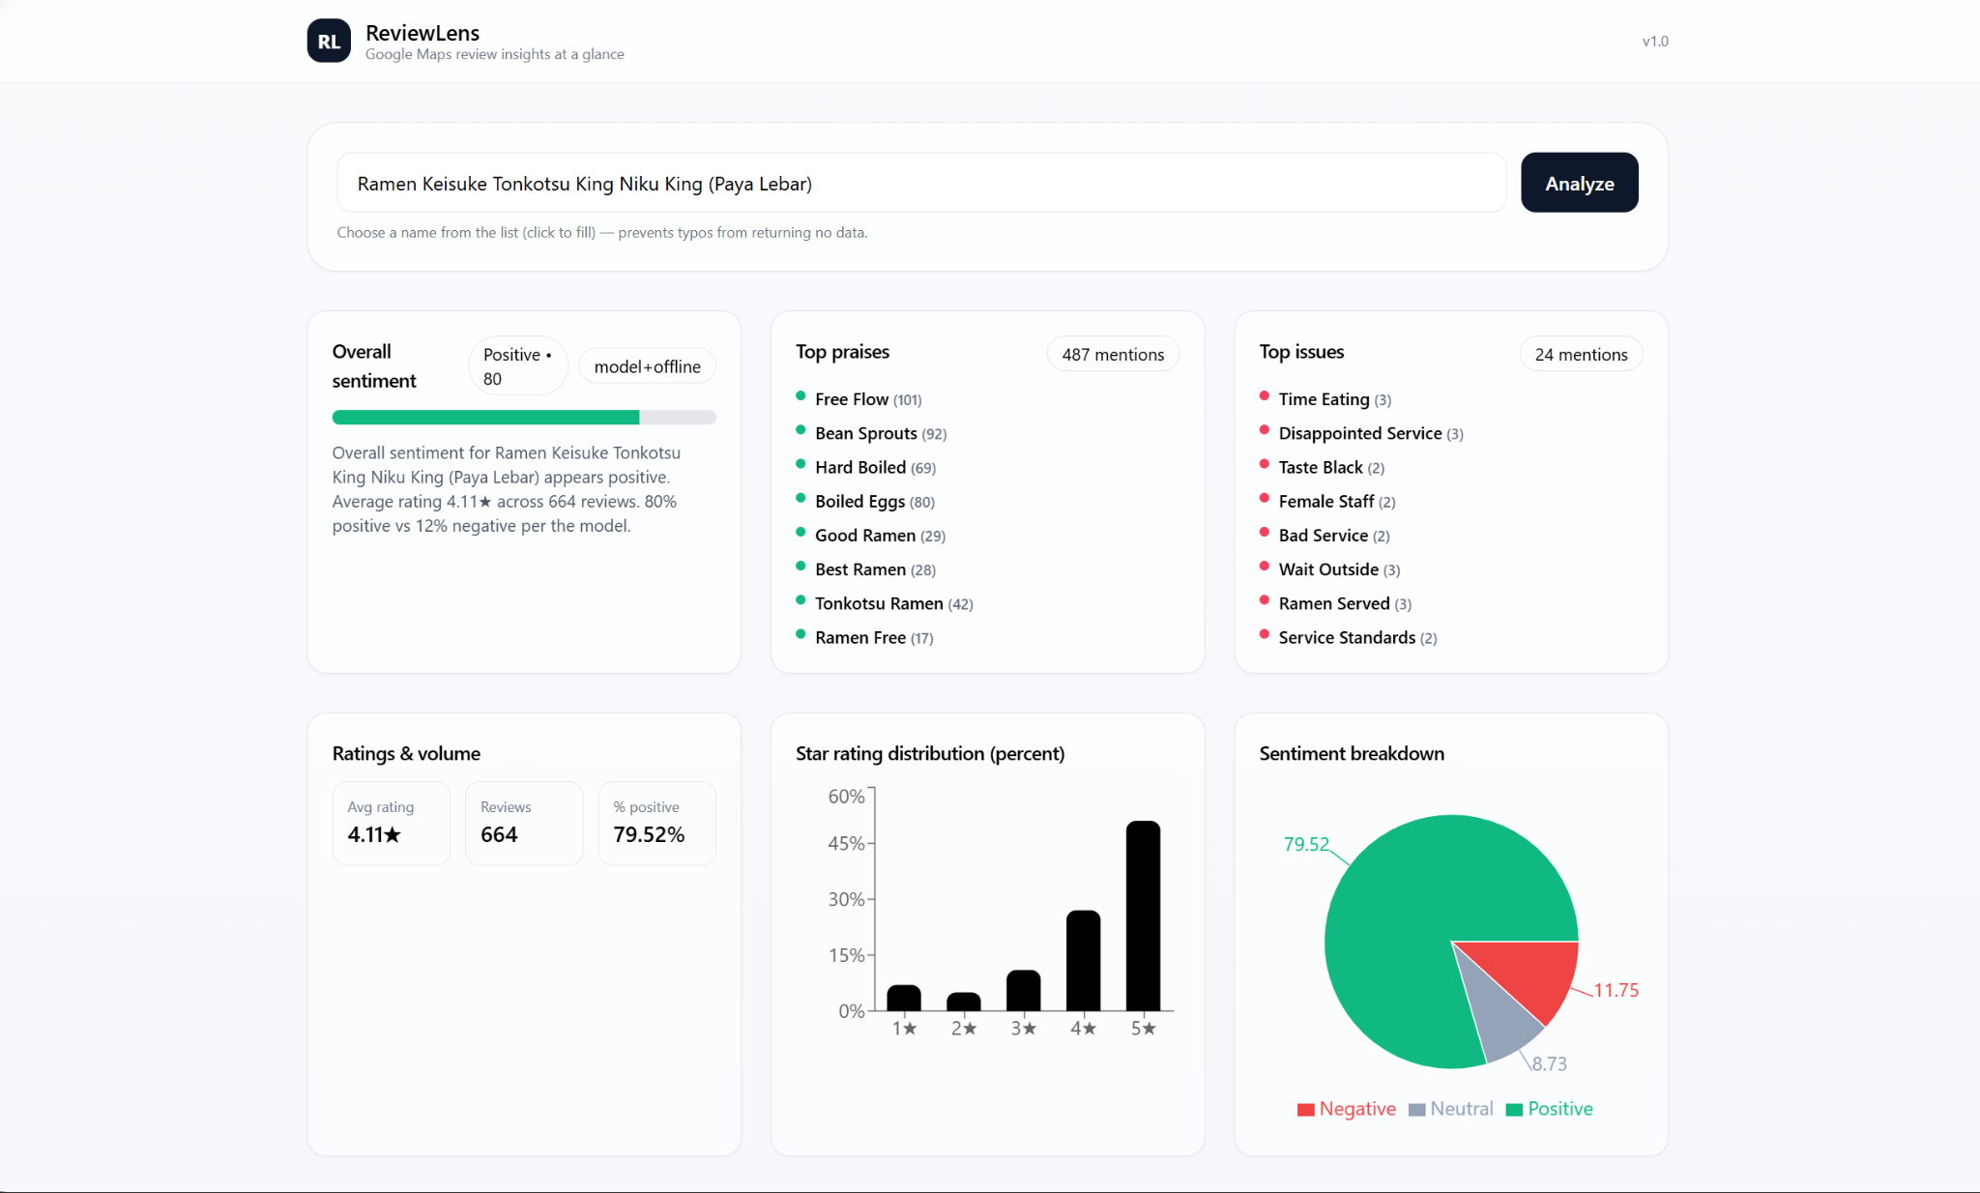
Demo

Slide 32
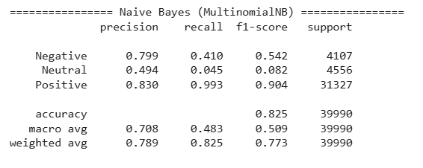
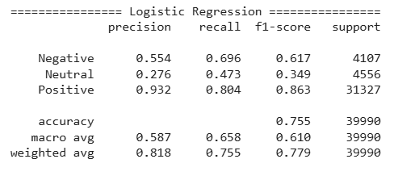
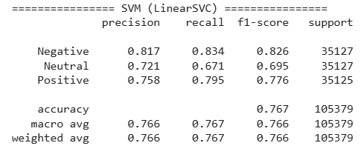
Insights
Unbalanced Dataset leads to inconclusive comparison and inaccurate accuracy
Naive Bayes had the highest 'Positive' F1-score (0.904) but was a complete failure on the 'Neutral' class.
Logistic Regression and SVM were more balanced between themselves, but both still performed very poorly on the 'Neutral' class.
Based on the macro avg F1-score, Naive Bayes (0.509) was far inferior, while Logistic Regression (0.610) and SVM (0.605) were in a statistical tie.
As a result of the data distortion, it was difficult to declare a best model among the 3 models tested.
Notes:
When the models were first evaluated on imbalanced datasets (31,327 positive instances, 4,107 negative instances, and 4,556 neutral instances), the substantial imbalance where the ‘Positive’ class constitutes approximately 78% of the data has significantly distorted model performance and hindered a fair comparison.

Slide 33
Current Limitation
Future Improvement
Stopwords removal is limited
Use Sentiment Lexicon Integration
TF-IDF is context-limited
Adopt contextual embeddings (e.g., BERT, Word2Vec).
Linear decision boundary
Try ensemble methods or deep learning (LSTM/BERT)
Hyper-parameter untuned
Run GridSearchCV for C (LogReg/SVM) & α (NB).
Notes:
Sentiment Lexicon Integration
-> having positive and negative list of words

Slide 34
Conclusion
Best Model (Balanced Dataset): SVM (LinearSVC) was the clear winner, delivering the highest accuracy and most balanced performance
  1. SVM: 0.922 Accuracy (Strongest & most balanced)
  2. Logistic Regression: 0.899 Accuracy (Good balance)
  3. Naive Bayes: 0.869 Accuracy (Struggled with "Neutral" class)
Key Insight: An unbalanced dataset severely skewed results, causing all models to fail on the "Neutral" class and resulting inaccurate and inconclusive results. This highlights that dataset quality is critical for model selection
Future Improvements:
  Adopt contextual embeddings such as BERT, Word2Vec over TF-IDF
  Perform hyperparameter tuning such as GridSearchCV

Slide 35
Thank you!

Slide 36
Insights
Class | Precision | Recall | F1-Score | Comments
Negative | 0.56 | 0.70 | 0.62 | Clear negative language
Neutral | 0.29 | 0.45 | 0.35 | Ambiguous tone
Positive | 0.93 | 0.83 | 0.87 | Strong keywords
Aspect | (1,2) n-gram | (1,3) n-gram | Insight
Macro F1 | 0.610 | 0.616 | Slight gain from including trigram.
Neutral Recall | 0.45 | 0.45 | Still low > Needs more data
Completion Time | Faster | Slightly Slower | Extra features increase training time mildly

Slide 37
Table of contents
01
02
03
04
05
Introduction
Dataset and
Classifiers used
Implementation steps
Results and
Discussion
Conclusion

Slide 38
Support Vector Machine (SVM)
Support Vector Machine is a discriminative classifier that aims to find the optimal hyperplane that maximally separates data points of different sentiment classes in the feature space. Unlike nonlinear SVM, which uses kernel functions to curve the decision boundary and capture more complex patterns, linear SVM learns a straight hyperplane in the TF-IDF feature space and is faster and more suitable for high-dimensional text data.
Hence, linear SVM is chosen for this project due to its efficiency and strong performance on text-based features.
Notes:
Explanation simplify

Slide 39
Models used for testing
“To understand model performance
under different assumptions
and complexity.”

Slide 40



—Someone Famous
“To understand model performance under different assumptions
and complexity.”

Slide 41
N-Grams
This is because N-grams capture the contextual information and semantics within a sequence of words, offering a more nuanced understanding of language essential for sentiment analysis.
For example, when the classifier trained on individual words, it might misinterpret "not good" as positive based on the word "good." This will lead to inaccurate sentiment analysis.
Jupiter
Saturn
Neptune
It is the biggest planet of them all
Saturn is a gas giant and has many rings
It’s the farthest planet from the Sun
It’s the closest planet to the Sun
Venus is the second planet from the Sun
Mars is actually a very cold place
Hence, by using N-grams, it allows our classifiers to consider combinations like "not good", resulting in more reliable sentiment analysis.
(Jain, 2024)

Slide 42
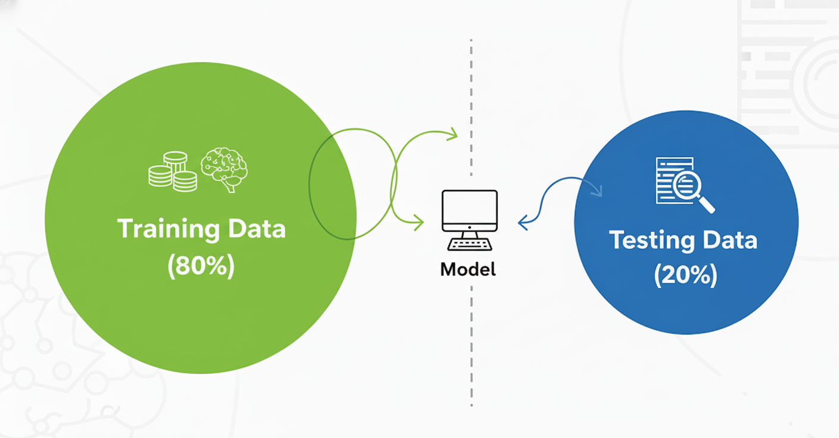
80/20 Train-Test Split
Next, the classifiers will be trained using an 80/20 train-test split. The 80/20 split is one of the most commonly used techniques for training machine learning models. This approach ensures that the model is trained on sufficient data (80%) while reserving the remaining 20% for testing on unseen data. This helps evaluate the model’s performance and ensures that it generalises well rather than becoming biased or overfitted.
Jupiter
Saturn
Neptune
It is the biggest planet of them all
Saturn is a gas giant and has many rings
It’s the farthest planet from the Sun
It’s the closest planet to the Sun
Venus is the second planet from the Sun
Mars is actually a very cold place
(GunKurnia, 2024)

Slide 43
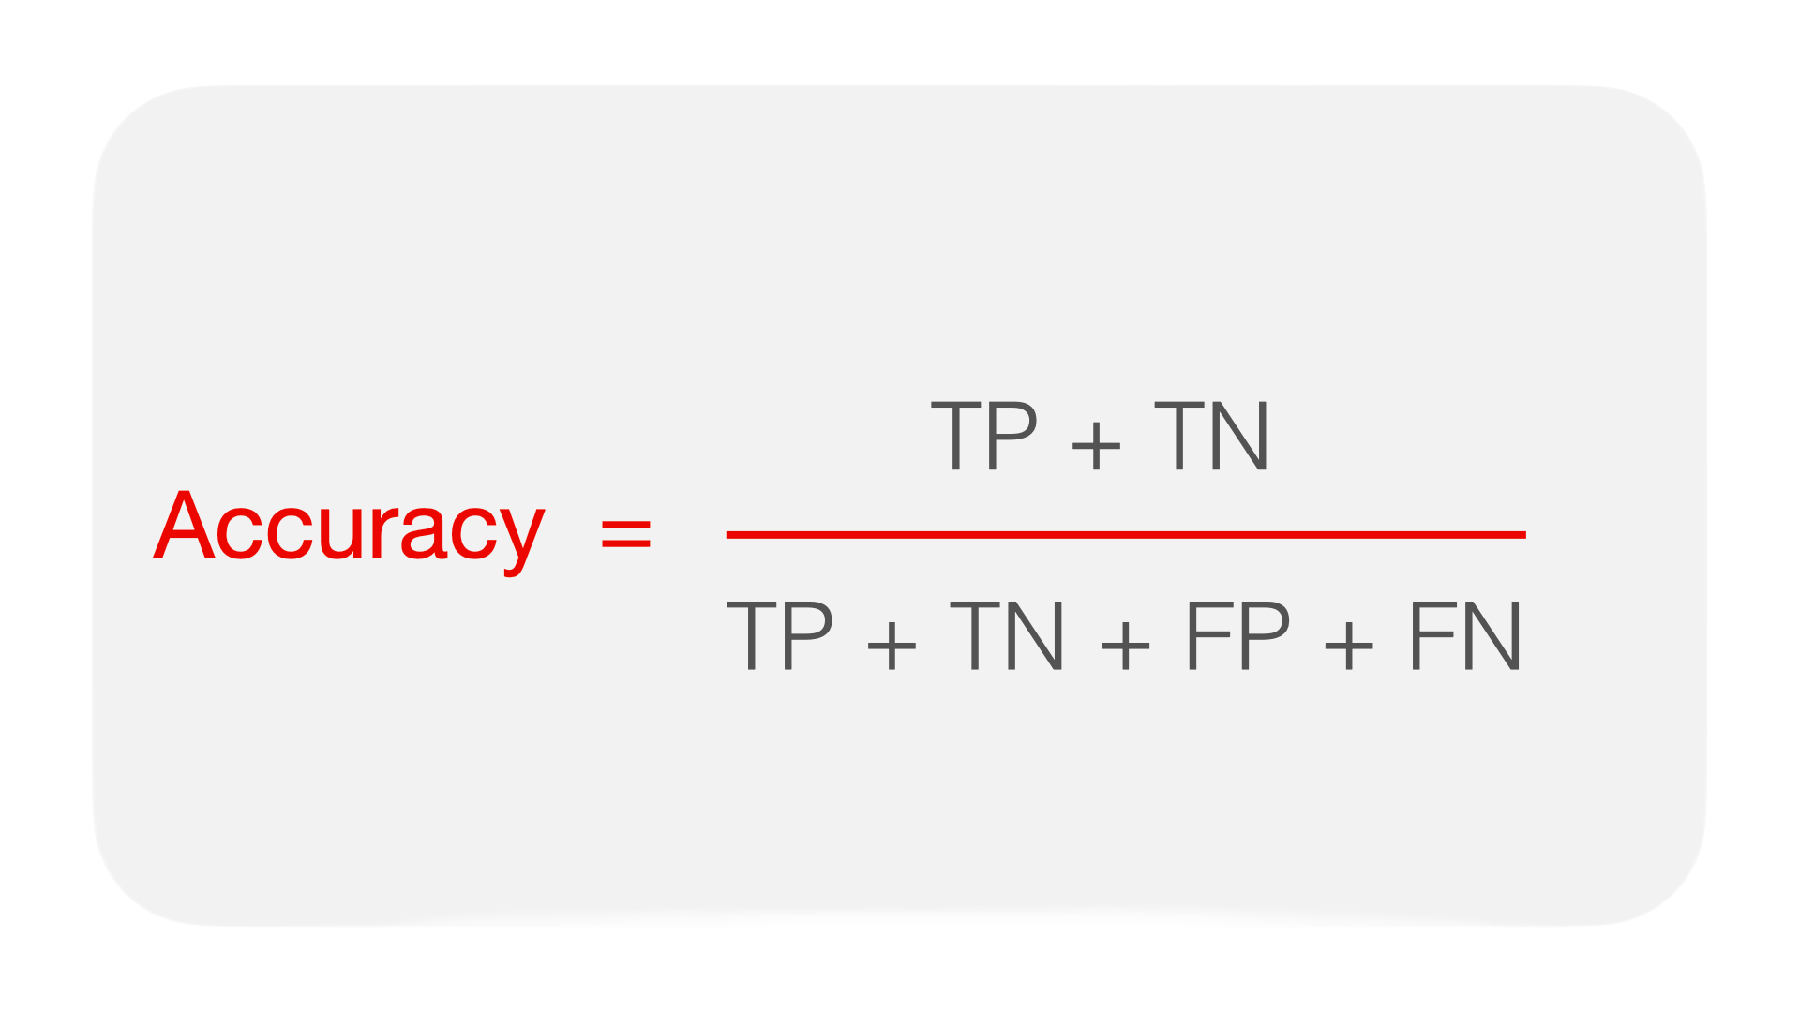
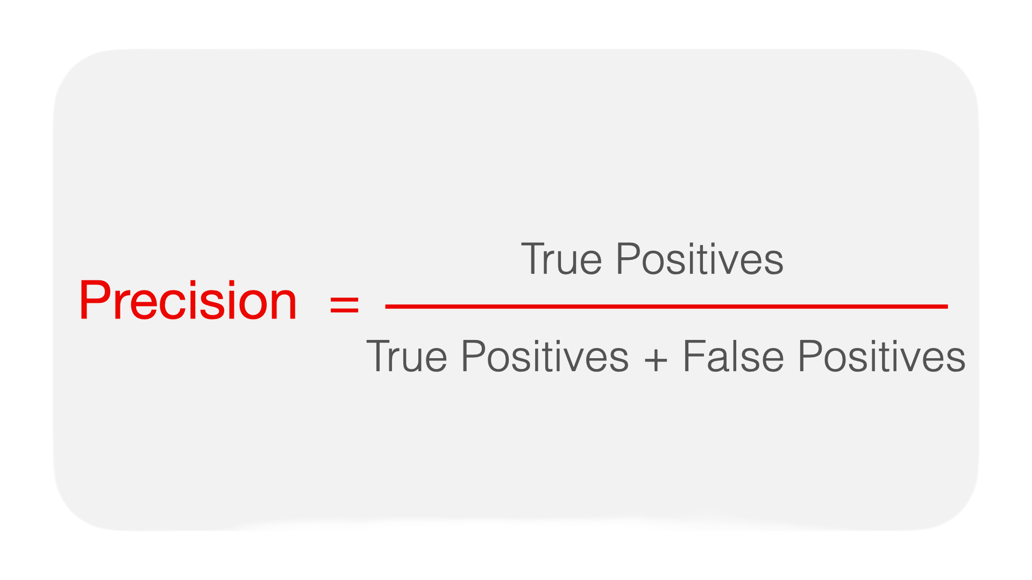
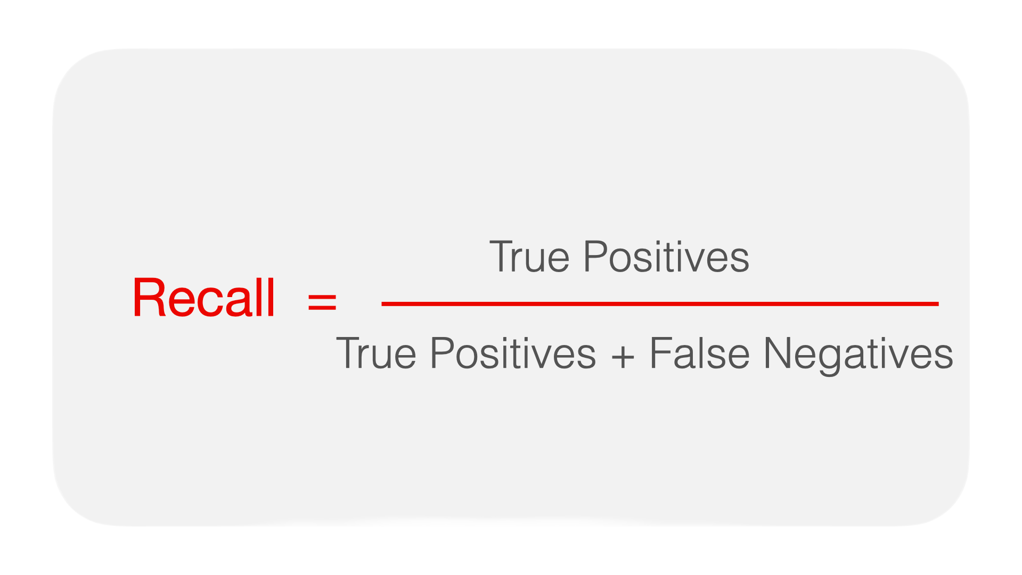
Implementation of Evaluation Strategies
Accuracy
Precision
Recall
overall performance
calculating the proportion of correctly predicted cases over total cases. Best for datasets with balanced classes as it does not reflect the model’s ability to predict specific classes in imbalanced
datasets
measures the accuracy of the model in predicting the positive class by calculating the proportion of correctly predicted positive cases out of all predicted positive cases. Best for datasets with imbalanced classes as it reflect the model correctness in identifying the target
class
measures the model’s ability to correctly identify the positive class by calculating the proportion of correctly predicted positive cases out of all actual positive cases. Best for datasets with imbalanced classes, as it reflects how well the model can detect the target class
(Accuracy vs. Precision vs. Recall in Machine Learning: What’s the Difference?, 2025)

Slide 44
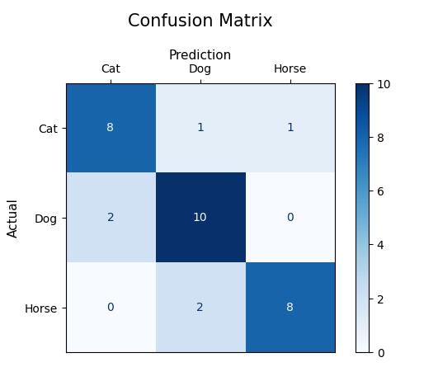
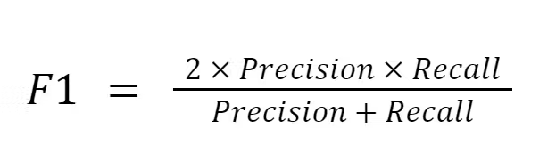
Implementation of Evaluation Strategies
F1-Score
Confusion Matrix
measures how well a classification model performs on a dataset. It is the harmonic mean of precision and recall, providing a balance between the two metrics. Best for datasets with imbalanced classes, as it reflects the model’s effectiveness in correctly identifying the target class.
evaluates the performance of a classification model by presenting the results in a tabular format through counting of true positives, true negatives, false positives, and false negatives. Best for datasets with imbalanced classes as it provides a detailed view of the model’s correctness in identifying each class
(GeeksforGeeks, 2017)
(GeeksforGeeks, 2023)

Slide 45
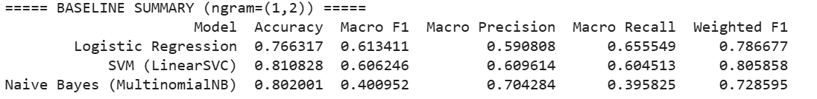
Results
Why N-gram Range (1,2) Works Best for Customer Reviews
Captures key two-word signals in reviews, like “not good,” “high quality,” “fast delivery,” and “poor service.”
Adds context that unigrams (1,1) miss, especially for sentiment and intent.
Avoids the huge, sparse feature space and overfitting that trigrams (1,3) cause in short, informal reviews.
Balances detail and reliability, making it strong for rating prediction, sentiment analysis, and topic detection.

Slide 46
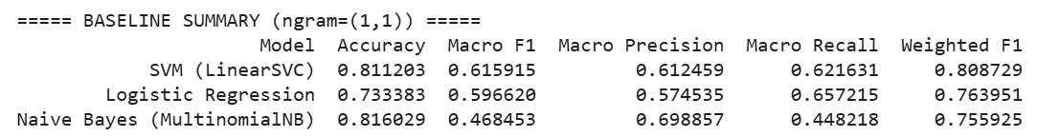
Results
Logistic Regression
Negative and Neutral recall are much better
Positive recall is slightly lower
Balanced macro stats show it focuses more evenly on all classes
Best for fair and balanced sentiment classification.

Slide 47
Discussion / Insights
Challenge
Results
Solution
Mercury is the closest planet to the Sun and the smallest in the entire Solar System
Venus has a beautiful name and is the second planet from the Sun
Despite being red, Mars is actually a cold place. It’s full of iron oxide dust

Slide 48


Limitations & Improvements
By Mercury
By Venus
“Mercury is the closest planet to the Sun and the smallest one in the Solar System—it’s only a bit larger than the Moon”
“Venus has a beautiful name and is the second planet from the Sun. It’s hot and has a very poisonous atmosphere”

Slide 49


Research resources
You can list your reference websites or publications here
You can list your reference websites or publications here
You can list your reference websites or publications here
You can list your reference websites or publications here
You can list your reference websites or publications here

Slide 50


A picture is worth a thousand words

Slide 51
Factors to consider
Venus
Jupiter
Mars
Saturn
Venus is the second planet from the Sun
Jupiter is the biggest planet of them all
Despite being red, Mars is a cold place
Saturn is a gas giant and has several rings

Slide 52
Clinical trial
Preclinical
Phase 01
Phase 02
Phase 03
Earth is the third planet from the Sun and the only one that harbors life in the Solar System. The Earth is where we all live
Human safety
Expanded safety
Efficacy & safety
10%
20%
70%
Venus
Mercury
Mars

Slide 53
Trial timeline
Despite being red, Mars is a cold place
Saturn is a gas giant and has rings
Preclinical
Analysis
Research
Experiment
Results
Venus has a beautiful name but it is hot
Jupiter is the biggest planet of them all
Earth is the third planet from the Sun

Slide 54
Phase 1
Sample
Effects
Results
456
75%
25%
Age: 35 - 45
345
Age: 46 -60
55%
Mercury is the closest planet to the Sun and the smallest one in the Solar System
245
Age: 61 - 70
Mars
Venus

Slide 55

Awesome words

Slide 56
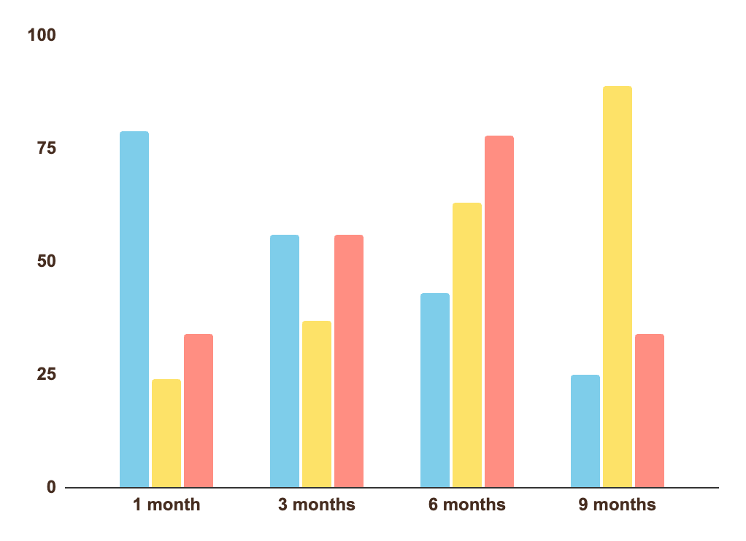
Tendency
Jupiter
It is a gas giant and the biggest planet of them all
Venus
Venus has a beautiful name, but it is very hot
Saturn
Saturn is composed of hydrogen and helium
Follow the link in the graph to modify its data and then paste the new one here. For more info, click here

Slide 57
Tendency in the world
Jupiter
It is a gas giant and the biggest planet of them all
40%
Saturn
Saturn is composed of hydrogen and helium
60%

Slide 58
Results
Outcome
Group | Test 01 | Test 02 | Test 03
A | 95/100 | 55/100 | 80/100
B | 80/100 | 25/100 | 66/100
C | 72/100 | 70/100 | 45/100
D | 60/100 | 60/100 | 86/100

Slide 59
Results analysis
Jupiter
60%
It is a big planet
Mars
Earth
Mercury
Mars is a very cold place
It is very small
Venus
40%
Sun
It has a nice name
Venus
Saturn
Venus has a nice name
It is a gas giant
Neptune

Slide 60

150,000
Big numbers catch your audience’s attention

Slide 61
Success rate
3m
45m
1k
Mars
Venus
Mercury
Despite being red, Mars is actually a cold place. It’s full of iron oxide dust
Venus has a beautiful name and is the second planet from the Sun
Mercury is the closest planet to the Sun and the smallest of them all

Slide 62


Computer mockup
You can replace the image on the screen with your own work. Just right-click on it and select “Replace image”

Slide 63

Conclusions
Mercury is the closest planet to the Sun and the smallest one in the Solar System—it’s only a bit larger than the Moon.
The planet’s name has nothing to do with the liquid metal, since it was named after the Roman messenger god, Mercury

Slide 64
Thanks!
Do you have any questions?
youremail@freepik.com
+91 620 421 838
yourwebsite.com

Slide 65
Icon pack

Slide 66
References
Jain, A. (2024, February 5). N-grams in NLP. Medium. https://medium.com/@abhishekjainindore24/n-grams-in-nlp-a7c05c1aff12
GunKurnia. (2024, September 11). Choosing the Optimal Data Split for Machine Learning: 80/20 vs 70/30? Medium.
https://medium.com/@gunkurnia/choosing-the-optimal-data-split-for-machine-learning-80-20-vs-70-30-0fd266710236
Accuracy vs. precision vs. recall in machine learning: what’s the difference? (2025). Evidentlyai.com. https://www.evidentlyai.com/classification-metrics/accuracy-precision-recall
GeeksforGeeks. (2017, October 15). Understanding the Confusion Matrix in Machine Learning.
GeeksforGeeks.
https://www.geeksforgeeks.org/machine-learning/confusion-matrix-machine-learning/
GeeksforGeeks. (2023, December 27). F1 Score in Machine Learning. GeeksforGeeks. https://www.geeksforgeeks.org/machine-learning/f1-score-in-machine-learning/
‌
‌
‌

Slide 67
Resources
Vectors
Watercolor national doctor's day
Collection of watercolor colored emoticons
Set of watercolor colorful emoticons
Photos
Woman with problems
Portrait of a smiling psychologist
Military man suffering from ptsd
Long shot of patient and psychologist
Smiling doctor consoling lovely couple
Icons
Icon Pack: Mental health | Filled
Did you like the resources on this template? Get them for free at our other websites:

